Slide 1
Android - Lecture 4

Slide 2
homework

Slide 3
Agenda
Fragments
Getting JSON from server, parsing and pushing back to server
C++ from Android

Slide 4
Fragments
A Fragment represents a behavior or a portion of user interface in a FragmentActivity. You can combine multiple fragments in a single activity to build a multi-pane UI and reuse a fragment in multiple activities. You can think of a fragment as a modular section of an activity, which has its own lifecycle, receives its own input events, and which you can add or remove while the activity is running (sort of like a "sub activity" that you can reuse in different activities).

Slide 5
Design Philosophy
Android introduced fragments in Android 3.0 (API level 11), primarily to support more dynamic and flexible UI designs on large screens, such as tablets. Because a tablet's screen is much larger than that of a handset, there's more room to combine and interchange UI components. Fragments allow such designs without the need for you to manage complex changes to the view hierarchy. By dividing the layout of an activity into fragments, you become able to modify the activity's appearance at runtime and preserve those changes in a back stack that's managed by the activity.

Slide 6
For example, a news application can use one fragment to show a list of articles on the left and another fragment to display an article on the right—both fragments appear in one activity, side by side, and each fragment has its own set of lifecycle callback methods and handle their own user input events. Thus, instead of using one activity to select an article and another activity to read the article, the user can select an article and read it all within the same activity, as illustrated

Slide 7
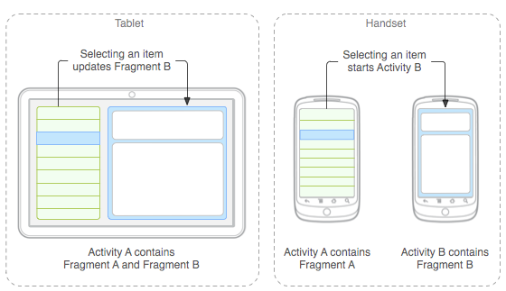
Fragments

Slide 8
You should design each fragment as a modular and reusable activity component. That is, because each fragment defines its own layout and its own behavior with its own lifecycle callbacks, you can include one fragment in multiple activities, so you should design for reuse and avoid directly manipulating one fragment from another fragment. This is especially important because a modular fragment allows you to change your fragment combinations for different screen sizes. When designing your application to support both tablets and handsets, you can reuse your fragments in different layout configurations to optimize the user experience based on the available screen space. For example, on a handset, it might be necessary to separate fragments to provide a single-pane UI when more than one cannot fit within the same activity.

Slide 9
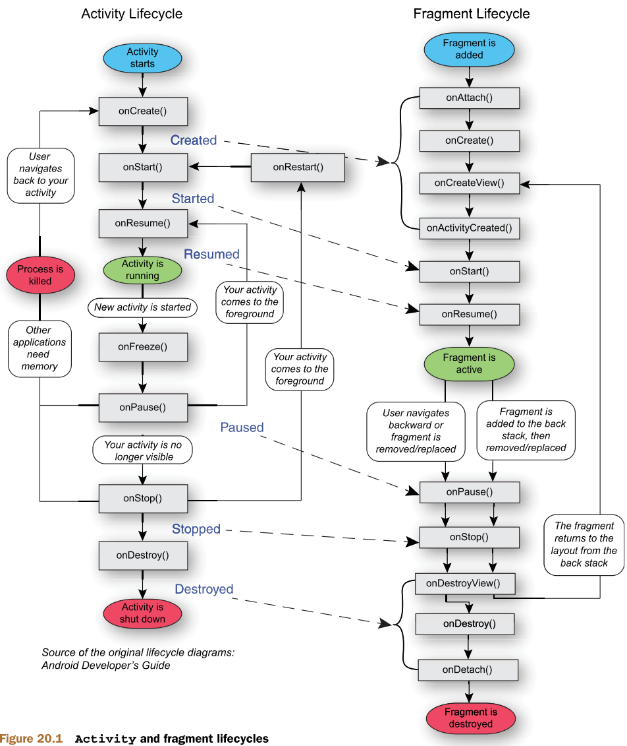

Slide 10
More:
https://developer.android.com/guide/components/fragments

Slide 11
Add C and C++ code to Your project
You can add C and C++ code to your Android project by placing the code into a cpp directory in your project module. When you build your project, this code is compiled into a native library that Gradle can package with your APK. Your Java or Kotlin code can then call functions in your native library through the Java Native Interface (JNI).
Android Studio's default build tool for native libraries is CMake. Android Studio also supports ndk-build due to the large number of existing projects that use the build toolkit to compile their native code.

Slide 12
More:
https://developer.android.com/studio/projects/add-native-code

Slide 13
Homework:
Move Gallery Activity to Fragment
Parse and show JSON from Meduza
https://meduza.io/api/v3/search?chrono=news&locale=ru&page=0&per_page=24

